Slide 1
PROBLEM STATEMENT/REQUIREMENTS
Client wants to create Road Accident Dashboard for year 2021 and year 2022 so that they can have a insights.
Primary KPI – Total Casualties taken place after the Accident.
Primary KPI- Total Casualties & Percentage of Total with respect to Accident Severity and Maximum Casualties by type of Vehicle.
Secondary KPI-Total Casualties with respect to Vehicle Type.
Monthly Trend showing comparison of casualties for current and previous year.
Maximum Casualties by Road Type.
Distribution of Total Casualties by Road Surface.
Relation between Casualties by Area/location and Day/Night.

Slide 2
STAKEHOLDERS
Ministry of Transport
Road Transport Department
Police Force
Emergency Services Department
Road Safety Corps
Transport Operator
Traffic Management Agencies
Public
Media

Slide 3
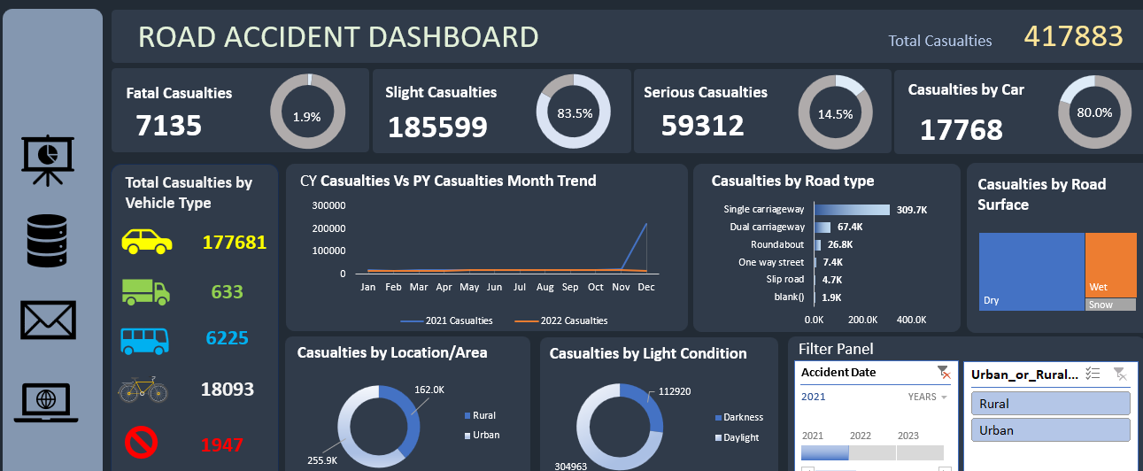

Slide 4
INSIGHTS
Total Casualties:
In 2022, the total number of casualties was 417,883.
Fatal Casualties:
Fatal casualties in 2022 decreased by 1.5% compared to 2021.
Serious Casualties:
Serious casualties were 14.5% in 2021 and decreased to 13.9% in 2022.
Slight Casualties:
Slight casualties accounted for 84.7% of the total casualties in 2022, showing an increase compared to 2021.
Casualties by Vehicle Type:
Casualties involving cars were higher in 2022 compared to 2021.
Casualties involving trucks were more prevalent in 2021 than in 2022.
.

Slide 5
INSIGHTS
Road Type:
The majority of casualties occurred on single carriageway roads.
Surface Conditions:
Dry road surfaces were more prone to causing casualties.
Time of Day:
The highest number of casualties occurred during the daytime.
Location:
Casualties were more frequent in urban areas than in rural settings.

